Slide 1

Technical Seminar Presentation(Preliminary/Final) on “Edge Computing”
Students:
Nitish k
(1RN19CS092)
Guide:
Prof. Mrs. Yashasvi B N
Asst. Prof. Dept. of CSE, RNSIT
Department of Computer Science and Engineering
RNS INSTITUTE OF TECHNOLOGY
2022-23

Slide 2
CONTENTS
INTRODUCTION
LITERATURE SURVEY
CHAPTER 3: Overview of Edge Computing
CHAPTER 4: Edge Computing Terms
CHAPTER 5: Edge Computing Methodology
Applications And Challenges
CONCLUSION
Conclusion
Future work
REFERENCES

Slide 3
INTRODUCTION
Edge Computing
CLOUD computing has tremendously changed the way we live, work, and study since its inception around 2005. Internet of Things (IoT) was first introduced to the community in 1999 for supply chain management, and was widely adapted to other fields such as healthcare, home, environment, and transports.
There will be 50 billion things connected to the Internet by 2020, as predicted by Cisco Internet Business Solutions Group.
Some IoT applications might require very short response time, some might involve private data, and some might produce a large quantity of data which could be a heavy load for networks.
With the push from cloud services and pull from IoT, we envision that the edge of the network is changing from data consumer to data producer as well as data consumer.
We start from the analysis of why we need edge computing, then we give our definition and vision of edge computing.

Slide 4
LITERATURE SURVEY
Edge Computing
Marieh Talebkhah; Aduwati Sali; Mohen Marjani; Meisam Gordan; Shaiful Jahari Hashim,” Edge computing: Architecture, Applications and Future Perspectives”. The rapid development of mobile internet and IoT has brought about significant challenges for traditional centralized cloud computing. In response, edge computing technologies like mobile edge computing, cloudlets, and fog computing have been introduced to migrate computational resources closer to users, improving cloud efficiency and expanding computational capability.
Gagandeep Kaur; Ranbir Singh Batth,” Edge Computing: Classification, Applications, and Challenges”:This paper introduces the edge computing model and its basic concepts, architecture, key technologies, security, and privacy protection. It provides data storage and computing at the edge of the network, supporting digital transformation and meeting industry requirements.
Author:Saksham Mittal; Neelam Negi; Rahul Chauhan,” Integration of edge computing with cloud computing”,Two papers on edge computing: one surveys virtual machine (VM) management, focusing on frameworks, techniques, server less management, and security; the other reviews existing edge computing systems and tools, categorizing them by design demands, and discussing energy efficiency and deep learning optimization. Edge computing integrates IoT, big data, and mobile computing, delivering on-demand computing power and enabling AI.

Slide 5
Overview of Edge Computing
Edge Computing
Edge Computing is a distributed computing paradigm in which processing and computation are performed mainly on classified device nodes known as smart devices or edge devices as opposed to processed in a centralized cloud environment or data centers.
It helps to provide server resources, data analysis, and artificial intelligence to data collection sources and cyber-physical sources like smart sensors and actuators.
This approach requires leveraging resources that may not be continuously connected to a network such as laptops, smartphones, tablets and sensors.
Edge computing covers a wide range of technologies including wireless sensor networks , mobile data acquisition, mobile signature analysis also classifiable as local cloud/fog computing and grid/mesh computing, dew computing, mobile edge computing, cloudlet, distributed data storage and retrieval, autonomic self-healing networks, remote cloud services, augmented reality, and more.
In the context of IIoT, ’edge’ refers to the computing infrastructure that exists close to the sources of data, for example, industrial controllers such as SCADA systems

Slide 6
Edge Computing

Slide 7
Edge Computing Terms
Edge Computing
Edge: What the edge is depends on the use case. In a telecommunications field, perhaps the edge is a cell phone or maybe it’s a cell tower. In an automotive scenario, the edge of the network could be a car. In manufacturing, it could be a machine on a shop floor; in enterprise IT, the edge could be a laptop.
Edge server: Edge servers can be defined as “a computer for running middleware or applications that sits close to the edge of the network, where the digital world meets the real world. Edge servers are put in warehouses, distribution centers and factories, as opposed to corporate headquarters.”
Edge devices: These can be any device that produces data. These could be sensors, industrial machines or other devices that produce or collect data.
Edge gateway: A gateway is the buffer between where edge computing processing is done and the broader fog network. The gateway is the window into the larger environment beyond the edge of the network.
Fat client: Software that can do some data processing in edge devices. This is opposed to a thin client, which would merely transfer data.

Slide 8
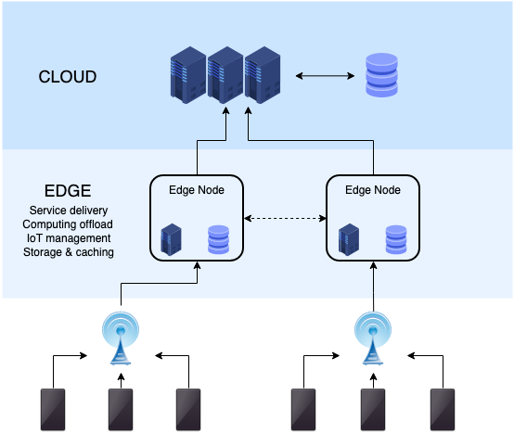
Edge Computing Architecture
Edge Computing

Slide 9
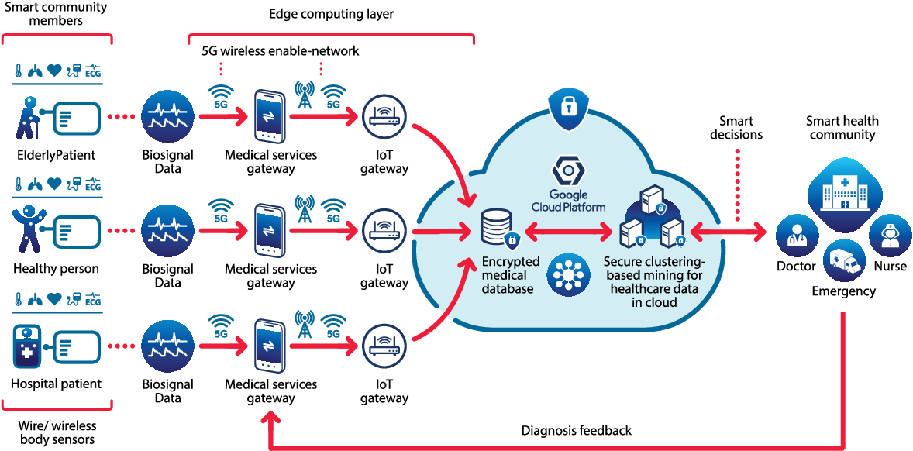
Edge Computing Methodology

Slide 10
Methodology in hospital patient monitoring
In the healthcare industry, edge computing is emerging as a promising technology for in-hospital patient monitoring. It enables real-time monitoring, personalized patient care, and remote monitoring while improving system reliability and security. Edge devices, such as sensors and wearables, can collect data on a patient's vital signs and generate personalized insights that can inform the patient's care plan. Edge computing can also reduce healthcare costs by enabling remote monitoring of patients, reducing the need for hospital readmissions.
Despite the early stages of adoption in healthcare, the potential of edge computing to revolutionize in-hospital patient monitoring is expected to drive its rapid growth in the coming years. Edge computing can enable timely intervention by healthcare professionals in critical care settings, reducing the risk of delayed response and improving patient outcomes. Additionally, edge computing can enhance the efficiency of in-hospital patient monitoring by reducing the amount of data that needs to be transmitted to the central server, mitigating security concerns and potential data loss due to network latency. The benefits of edge computing for in-hospital patient monitoring make it a promising technology for the healthcare industry, with the potential to improve patient outcomes and reduce healthcare costs.

Slide 11
Applications of Edge Computing
Edge Computing
Autonomous vehicles
In-hospital patient monitoring
Traffic management
Cloud gaming
Content delivery
Smart grid

Slide 12
Edge computing challenges
Edge Computing
Network bandwidth
Security:
Geolocation
Data Loss Protection and Backups
The edge computing framework:

Slide 13
CONCLUSION
Edge Computing
The adoption of cloud computing brought data analytics to a new level. The interconnectivity
of the cloud enabled a more thorough approach to capturing and analyziEdge computing is a viable solution for data-driven operations that require lightning-fast results
and a high level of flexibility, depending on the current state of things. The idea is to get closer
to devices to reduce the amount of data that needs to be transferred, which results in better
response timeng data. Edge computing is particularly relevant in the context of IIoT, where it enables real-time
processing of data from sensors and devices, enabling faster decision-making and reducing the
need for large amounts of data to be transmitted to the cloud

Slide 14
REFERENCES
Edge Computing
[1] D. Evans , “The Internet of Things How The Next Evolution of the Internet is Changing Everything. Accessed: Dec. 3, 2016. [Online].
[2] M. Satyanarayanan, “The emergence of edge computing,” Computer, vol. 50, no. 1, pp.3039, Jan. 2017.
[3] W. Shi, H. Sun, J. Cao, Q. Zhang, and W. Liu, “Edge computing-an emerging computing model for the Internet of everything era,” J. Comput. Res. Develop., vol. 54, no. 5, pp. 907924, May 2017.
[4] W. S. Shi, X. Z. Zhang, and Y. F.Wang, “Edge computing: State-of-the-art and future directions,” J. Comput. Res. Develop., vol. 56, no. 1, pp. 121, 2019.
[5] X. Sun and N. Ansari, “Edge IoT: Mobile edge computing for the Internet of Things,” IEEE Commun. Mag., vol. 54, no. 12, pp. 2229, Dec. 2016.
[6] Baker SB, Xiang W, Atkinson I. Internet of Things for Smart Healthcare: Technologies,
Challenges, and Opportunities. IEEE Access 2017; 5: 26521-26544. doi: 10.1109/ACCESS.
2017.2775180

Slide 15
SUGGESTIONS….!

Slide 16
THANK YOU!!!

